Slide 1



Python 3 Beginner
Chapter 00
Previously, on Python 3 Beginner…
release 1.0.0
37/39 Avenue Ledru Rollin – CS 11237 – 75750 PARIS CEDEX 12 - info@valnaos.com – www.valnaos.com Tél : 01 86 95 20 48

Slide 2

What we saw last time
Python 3 Beginner
How to define functions in Python
Variable scope in functions
Caveats and dangers of global scope, ownership and mutability in functions
Functional programming basics

Slide 3

Cloud Technology Associate
Copyright © 2018 | 9
Q&A
37/39 Avenue Ledru Rollin – CS 11237 – 75750 PARIS CEDEX 12 - info@valnaos.com – www.valnaos.com Tél : 01 86 95 20 48

Slide 4

Where? Who?
Python 3 Beginner
Class Material
GitHub: https://github.com/cstar-industries/python-3-beginner
Instructor
Charles Francoise <charles@cstar.io>

Slide 5

Session Objectives
Python 3 Beginner
At the end of this session, you will be able to:
Perform operations on the filesystem and paths
Read from and write to files
Handle base64-encoded data
Serialize/deserialize python objects to pickle and JSON
Use math functions and random number generators
Handle date and time data with ease in Python
Be curious to learn more about regular expressions

Slide 6
Session Syllabus
Python 3 Beginner
Chapter | Subject | Start | End | Total Time (in hours)
00 | Previously on Python 3 Beginner… | 14:00 | 14:30 | 00:30
01 | A Guided Tour of the Python Standard Library | 14:30 | 15:15 | 00:45
 | Coffee Break | 15:15 | 15:30 | 00:15
01 | A Guided Tour of the Python Standard Library | 15:30 | 16:15 | 00:45
 | Coffee Break | 16:15 | 16:30 | 00:15
01 | A Guided Tour of the Python Standard Library | 16:30 | 17:15 | 00:45
 | Workshop | 17:15 | 18:00 | 00:45
 | Total |  |  | 04:00

Slide 7
Python 3 Beginner
Chapter 01
A guided tour of the Python Standard Library
release 1.0.0
37/39 Avenue Ledru Rollin – CS 11237 – 75750 PARIS CEDEX 12 - info@valnaos.com – www.valnaos.com Tél : 01 86 95 20 48

Slide 8
Dealing with files: opening
Python 3 Beginner
Open a file using the built-in function open
f = open('hello.txt')
print(f.read())
f.close()
hello
Opening a file can fail: remember to catch errors
f = open('hello.txtx')
FileNotFoundError: [Errno 2] No such file or directory: 'hello.txtx'

Slide 9
Dealing with files: opening
Python 3 Beginner
An open file should always be closed
f = open('hello.txt')
...
f.close()
⚠️Errors can happen here
Use a with statement to make sure file is closed
with open('hello.txt') as f:
data = f.read()
print(f.closed)
True

Slide 10
Dealing with files: opening
Python 3 Beginner
By default, a file is not writable
with open('hello.txt') as f:
f.write('Hello World!')
UnsupportedOperation: not writable
Use the mode argument
with open('hello.txt', 'w') as f:
f.write('Hello World!')
"Write mode"

Slide 11
Dealing with files: opening
Python 3 Beginner
There are many modes to open a file
Character | Meaning
r | open for reading (default)
w | open for writing, truncating the file first
x | open for exclusive creation, failing if the file already exists
a | open for writing, appending to the end of the file if it exists
b | binary mode
t | text mode (default)
+ | open for updating (reading and writing)
Mode characters can be combined:
'r+b' opens the file for reading and writing in binary mode
See the documentation to learn more about open

Slide 12
Dealing with files: reading and writing
Python 3 Beginner
Read from a file with the read method
print(f.read(3)) # Number of bytes/characters to be read
print(f.read()) # Read to end of file
hel
lo
Write to a file with the write method
f.write('Hello ')
f.write('World!')
...
print(f.read())
Hello World!

Slide 13
Dealing with files: reading and writing
Python 3 Beginner
Move your cursor with the seek method and find out your current position with the tell method
f.seek(4)
print(f.tell())
print(f.read())
o
Find out more about files and file-like objects in the documentation

Slide 14
Let’s write some code!
Python 3 Beginner
with open('hello.txt', 'w') as f:
f.write('Hello World!')
with open('hello.txt') as f:
print(f.read())
Hello World!

Slide 15
Interacting with the operating system: the os module
Python 3 Beginner
import os
import os.path
The built-in os module provides a way to call operating system functions from Python
Environment variables
Filesystem operations
Process management
Cryptographically-secure random numbers
⚠️ Not all functions are portable between OSes (Linux, macOS, BSD, Windows...)
Find a comprehensive list of the os module in the documentation

Slide 16
Reading environment variables
Python 3 Beginner
You can list all variables defined in your current environment with os.environ
os.environ
environ{'TERM': 'xterm-256color',
'SHELL': '/bin/bash',
'TMPDIR': '/var/folders/_7/5ywmfgxn1v50w94f4bp5ql080000gn/T/',
'LC_ALL': 'en_US.UTF-8',
'USER': 'chrales',
...
Get the value of a single environment variable or a default value if it is undefined
os.getenv('USER', default='python')
'chrales'

Slide 17
Filesystem operations
Python 3 Beginner
List the contents of a directory
os.listdir()
['001-First-Steps', '004-Functions-And-More', '003-Data-Structures', 'README.md', '002-Control-Flow']
os.listdir('/bin')
['cat', 'echo', 'launchctl', 'df', 'pwd', 'test', 'csh', 'wait4path', 'unlink'...
Change the current directory
os.chdir('001-First-Steps')

Slide 18
Filesystem operations
Python 3 Beginner
Create a directory
os.mkdir('new-directory')
Remove a directory
os.rmdir('new-directory')
Rename (move) a file or directory
os.rename('hello.txt', 'hello-world.txt')
os.rename('hello.txt', '005-Python-Standard-Library/hello.txt')
Remove a file
os.remove('005-Python-Standard-Library/hello.txt')

Slide 19
Filesystem operations
Python 3 Beginner
Create a symbolic link (Windows "shortcut")
os.symlink('Shortcut to classes', '/home/chrales/Classes/python-3-beginner')
Reading a symbolic link
os.readlink('Shortcut to classes')
['cat', 'echo', 'launchctl', 'df', 'pwd', 'test', 'csh', 'wait4path', 'unlink'...

Slide 20
Filesystem operations
Python 3 Beginner
Query info about paths
os.path.exists('hello.txt')
True
print(os.path.isfile('hello.txt'))
print(os.path.isdir('hello.txt'))
True
False
os.path.getsize('hello.txt')
13

Slide 21
Filesystem operations
Python 3 Beginner
Extract path components
os.path.split('/home/chrales/Work/python-3-beginner/README.md')
('/home/chrales/Work/python-3-beginner', 'README.md')
print(os.path.dirname('/home/chrales/Work/python-3-beginner/README.md'))
print(os.path.basename('/home/chrales/Work/python-3-beginner/README.md'))
/home/chrales/Work/python-3-beginner
README.md
os.path.splitext('README.md')
('hello', '.txt')

Slide 22
Filesystem operations
Python 3 Beginner
Join path components
os.path.join('/home/chrales', 'Work', 'python-3-beginner', 'README.md')
'/home/chrales/Work/python-3-beginner/README.md'
Get the absolute canonical path (resolve symlinks, relative paths)
os.path.realpath('../python-3-beginner/README.md')
'/home/chrales/Work/python-3-beginner/README.md'

Slide 23
Let’s write some code!
Python 3 Beginner
with open('hello.txt', 'w') as f:
f.write('Hello World!')
with open('hello.txt') as f:
print(f.read())
Hello World!

Slide 24
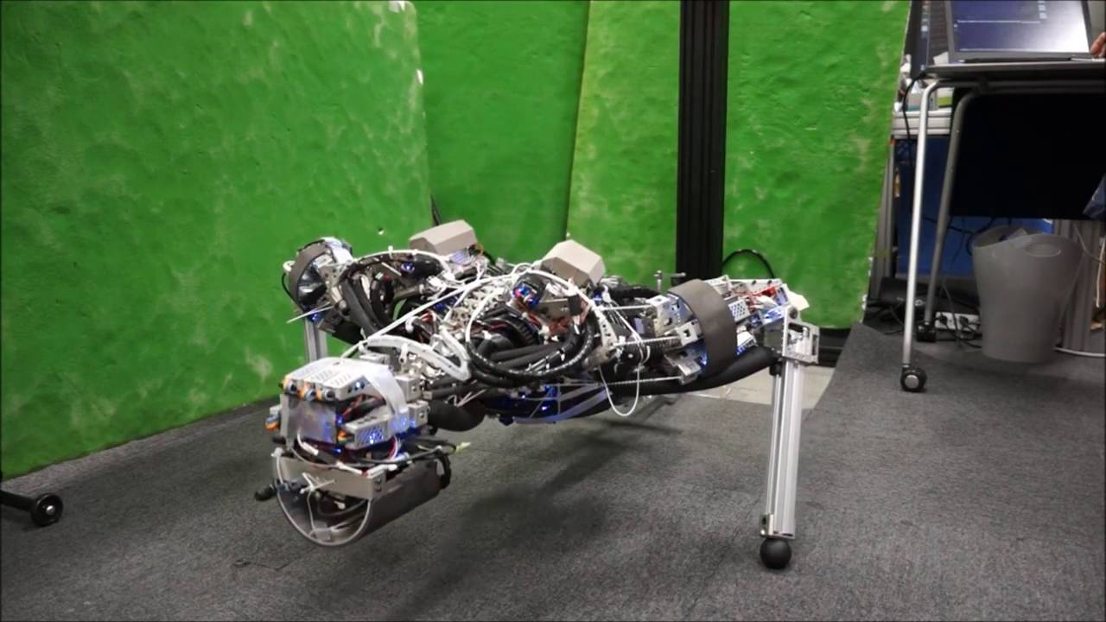
Workout Time!
Python 3 Beginner
Notes:
https://github.com/cstar-industries/python-3-beginner/blob/master/001-First-Steps/First%20Steps%20-%20Chap%2001%20-%20Exercises.ipynb

Slide 25
Regular expressions: the re module
Python 3 Beginner
import re
The built-in re module provides regular expression matching operations
Find out more about the re module in the documentation
Learn about regular expressions at https://regexone.com
Play regular expressions crosswords at https://regexcrossword.com
Test and debug your regular expressions at https://regex101.com

Slide 26
Regular expressions: the re module
Python 3 Beginner
Match a regex in a string
m = re.match(r'a+b', 'aaaab')
print(m)
<re.Match object; span=(0, 5), match='aaaab'>
m = re.match(r'a+b', 'baba')
print(m)
None
m = re.search(r'a+b', 'baba')
print(m)
<re.Match object; span=(1, 3), match='ab'>

Slide 27
Regular expressions: the re module
Python 3 Beginner
Replace ("substitute") occurrences of a regex
re.sub(r'a+', 'a', 'aaaaa-aaa-aaaaaa-a-bbb')
'a-a-a-a-bbb'
re.sub(r'\D', '', '(460)190-2235')
'4601902235'
Split a string using a regular expression
re.split(r'[-_/]', 'hello-world/python_rocks')
['hello', 'world', 'python', 'rocks']

Slide 28
Encoding binary data to text with base64
Python 3 Beginner
Base-64 is a text-only encoding that can be used to encode any binary data to 64 "safe" characters:
A-Z uppercase: 26
a-z lowercase: 26
0-9 digits: 10
+ and /: 2
This encoding is useful for sending binary data over the network (e.g. by email) where unexpected character re-interpretation can occur
Often used to transfer cryptographic keys and certificates

Slide 29
Encoding and decoding with base64
Python 3 Beginner
Encode binary data to base64
base64.b64encode(b'Hello World')
b'SGVsbG8gV29ybGQh'
Encode base64 to binary data
base64.b64decode(b'SGVsbG8gV29ybGQh')
b'Hello World!'

Slide 30
Math functions with the math module
Python 3 Beginner
import math
Math constants
math.pi
3.141592653589793
math.e
2.718281828459045
math.tau
6.283185307179586

Slide 31
Math functions with the math module
Python 3 Beginner
Sentinel values
math.nan
nan
math.inf
inf
-math.inf
-inf

Slide 32
Math functions with the math module
Python 3 Beginner
Convert from degrees to radians
math.radians(180)
3.141592653589793
math.degrees(math.pi / 4)
45.0
Use trigonometric functions
math.cos(math.pi / 3)
0.5

Slide 33
Math functions with the math module
Python 3 Beginner
More math functions
math.log(2) # natural logarithm
math.log10(100) # base 10 logarithm
math.log2(1024) # base 2 logarithm
math.acos(0.707) # Inverse cosine
math.tanh(1) # Hyperbolic tangent
math.gcd(16, 642) # Greatest common divisor
math.hypot(3, 4) # Hypothenuse (Pythagoras theorem)
Read the list of math functions in the documentation

Slide 34
Random functions
Python 3 Beginner
import random
Get a random number between 0 and 1
random.random()
0.07460955954672188
Get a random integer between 10 and 100
random.randrange(10, 100)
59

Slide 35
Random functions
Python 3 Beginner
Get a random item from a sequence
random.choice(['banana', 'pear', 'orange', 'peach'])
'pear'
Pick a random item 5 times
random.choices(['banana', 'pear', 'orange', 'peach'], k=5)
['banana', 'orange', 'banana', 'peach', 'orange']
Pick 2 distinct items randomly
random.sample(['banana', 'pear', 'orange', 'peach'], k=2)
['peach', 'banana']

Slide 36
Random functions
Python 3 Beginner
Get a random item from a sequence
random.choice(['banana', 'pear', 'orange', 'peach'])
'pear'
Pick a random item 5 times
random.choices(['banana', 'pear', 'orange', 'peach'], k=5)
['banana', 'orange', 'banana', 'peach', 'orange']
Pick 2 distinct items randomly
random.sample(['banana', 'pear', 'orange', 'peach'], k=2)
['peach', 'banana']

Slide 37
Random functions
Python 3 Beginner
Various random distributions
random.uniform(10, 100)
80.58706066003606
random.gauss(0.0, 1.0)
-0.4858548215268525
random.betavariate(2.0, 2.0)
0.8849856235679385

Slide 38
Managing time: the datetime module
Python 3 Beginner
Time and date is a hard subject in programming. Python makes it easy for us.
Well... easier (documentation)
from datetime import datetime, timedelta, timezone
Get the current time and date as a datetime object
t = datetime.now()
t
datetime.datetime(2020, 4, 22, 22, 54, 13, 837398)
datetime(year, month, day, hours, minutes, seconds, nanoseconds)

Slide 39
Managing time: the datetime module
Python 3 Beginner
Create an arbitrary datetime object
t2 = datetime(year=1984, month=1, day=24)
print(t2)
1984-01-24 00:00:00
Compare datetimes
print(t < t2) # t happens before t2
print(t > t2) # t happens after t2
False
True

Slide 40
Managing time: the datetime module
Python 3 Beginner
Get the duration between two datetimes
t – t2
datetime.timedelta(days=13238, seconds=83603, microseconds=66028)
Create an arbitrary timedelta
d = timedelta(days=1, hours=5)
Perform time calculations
t – d # 1 day and 5 hours before
datetime.datetime(2020, 4, 21, 18, 13, 23, 66028)

Slide 41
Managing time: the datetime module
Python 3 Beginner
Create an arbitrary datetime object
t2 = datetime(year=1984, month=1, day=24)
print(t2)
1984-01-24 00:00:00
Compare datetimes
print(t < t2) # t happens before t2
print(t > t2) # t happens after t2
False
True

Slide 42
Managing time: the datetime module
Python 3 Beginner
Get a float timestamp, the # of seconds since Jan 1, 1970 00:00 UTC
t.timestamp()
1587590547.289774
Get a datetime from a timestamp
datetime.fromtimestamp(0.0)
datetime.datetime(1970, 1, 1, 1, 0)

Slide 43
Managing time: the datetime module
Python 3 Beginner
Output a datetime in ISO 8601 format
t.isoformat()
'2020-04-22T23:13:23.066028'
Output a datetime to a custom format
t.strftime('%a, %b %d %H:%m %Y')
'Wed, Apr 22 23:04 2020'

Slide 44
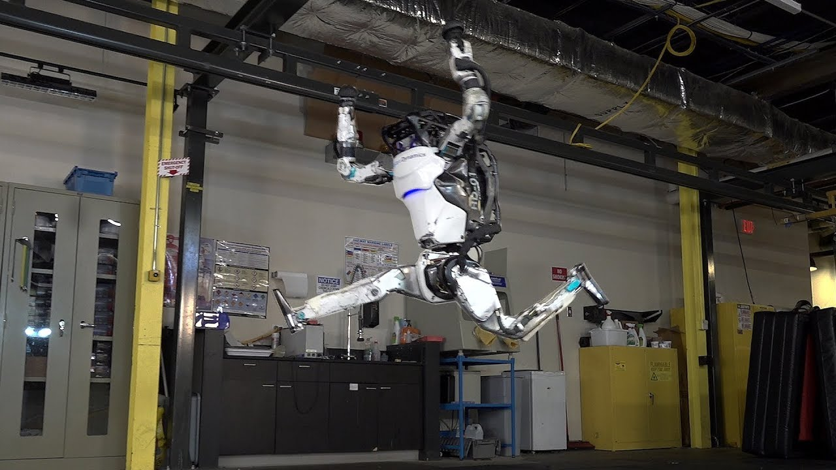
Workout Time!
Python 3 Beginner
Notes:
https://github.com/cstar-industries/python-3-beginner/blob/master/001-First-Steps/First%20Steps%20-%20Chap%2002%20-%20Exercises.ipynb

Slide 45
Serializing Python data: the pickle module
Python 3 Beginner
import pickle
Save a Python object to a file
d = {'date': datetime.now(), 'temperature': 19.7, 'python': 'snek'}
with open('python_obj.pickle', 'wb') as f:
pickle.dump(d, f)
00000000 80 03 7d 71 00 28 58 04 00 00 00 64 61 74 65 71 |..}q.(X....dateq|
00000010 01 63 64 61 74 65 74 69 6d 65 0a 64 61 74 65 74 |.cdatetime.datet|
00000020 69 6d 65 0a 71 02 43 0a 07 e4 04 16 17 38 14 0c |ime.q.C......8..|
00000030 de ae 71 03 85 71 04 52 71 05 58 0b 00 00 00 74 |..q..q.Rq.X....t|
00000040 65 6d 70 65 72 61 74 75 72 65 71 06 47 40 33 b3 |emperatureq.G@3.|
00000050 33 33 33 33 33 58 06 00 00 00 70 79 74 68 6f 6e |33333X....python|
00000060 71 07 58 04 00 00 00 73 6e 65 6b 71 08 75 2e |q.X....snekq.u.|

Slide 46
Serializing Python data: the pickle module
Python 3 Beginner
Reading a Python object back from a pickle file
with open('python_obj.pickle', 'rb') as f:
d2 = pickle.load(f)
print(d2)
{'date': datetime.datetime(2020, 4, 22, 21, 59, 41, 32105), 'temperature': 19.7, 'python': 'snek'}
d2 == d
True

Slide 47
Serializing Python data: the json module
Python 3 Beginner
import json
JSON is a text-based, human-readable, interchange format based on JavaScript
It is ubiquitous as a data format, particularly from web services
JSON is common in many programming languages, making a good interchange format between programs
⚠️ Not all Python object can be serialized to or deserialized from JSON

Slide 48
Serializing Python data: the json module
Python 3 Beginner
Reading data from a JSON string
json_data = '{"first_name": "Rob", "last_name": "Pike", "occupation": "programmer"}'
d = json.loads(json_data)
print(d)
{'first_name': 'Rob', 'last_name': 'Pike', 'occupation': 'programmer'}
Writing a Python object to a JSON file
with open('python_obj.json', 'w') as f:
json.dump(d, f)
00000000 7b 22 66 69 72 73 74 5f 6e 61 6d 65 22 3a 20 22 |{"first_name": "|
00000010 52 6f 62 22 2c 20 22 6c 61 73 74 5f 6e 61 6d 65 |Rob", "last_name|
00000020 22 3a 20 22 50 69 6b 65 22 2c 20 22 6f 63 63 75 |": "Pike", "occu|
00000030 70 61 74 69 6f 6e 22 3a 20 22 70 72 6f 67 72 61 |pation": "progra|
00000040 6d 6d 65 72 22 7d |mmer"}|

Slide 49
Serializing Python data: the csv module
Python 3 Beginner
import csv
Reading a CSV file
with open('tesla-stock-price.csv', newline='') as f:
csv_data = csv.reader(f, delimiter=",", quotechar='"')
for row in csv_data:
print(row)
['date', 'close', 'volume', 'open', 'high', 'low']
['11:34', '270.49', '4,787,699', '264.50', '273.88', '262.24']
['2018/10/15', '259.5900', '6189026.0000', '259.0600', '263.2800', '254.5367']
['2018/10/12', '258.7800', '7189257.0000', '261.0000', '261.9900', '252.0100']
['2018/10/11', '252.2300', '8128184.0000', '257.5300', '262.2500', '249.0300']
['2018/10/10', '256.8800', '12781560.0000', '264.6100', '265.5100', '247.7700']
['2018/10/09', '262.8000', '12037780.0000', '255.2500', '266.7700', '253.3000']
...

Slide 50
Serializing Python data: the csv module
Python 3 Beginner
Writing a CSV file
with open('contacts.csv', 'w', newline='') as f:
csv_file = csv.writer(f)
csv_file.writerow('First name', 'Last name', 'Phone number')
csv_file.writerows(contacts) # contacts is a list of lists
Discover more about pickle, json and csv in the documentation

Slide 51
Manipulating zip files: the zipfile module
Python 3 Beginner
from zipfile import ZipFile
Opening a zip file
z = ZipFile('archive.zip')
...
z.close()
You can use a with statement with ZipFile
with ZipFile('archive.zip') as z:
...

Slide 52
Manipulating zip files: the zipfile module
Python 3 Beginner
List all files in an archive
for filename in z.namelist():
print(filename)
photos/
photos/IMG_0689.jpg
photos/IMG_0690.jpg
photos/IMG_0691.jpg
...
Extract all files from an archive
z.extractall() # Extracts to current directory
z.extractall('/home/chrales/pictures') # Extracts to given directory

Slide 53
Manipulating zip files: the zipfile module
Python 3 Beginner
Extract a specific file (destination path is optional)
z.extract('photos/IMG_0690.jpg', 'IMG_0690.jpg')
Read the contents of a file to bytes
file_data = z.read('photos/IMG_0690.jpg')
print(file_data)
b'\xff\xd8\xff\xe0\x00\x10JFIF\x00\x01\x01\x00\x00\x01...
Close a zip file
z.close()

Slide 54
Manipulating zip files: the zipfile module
Python 3 Beginner
You can also create zip files and write to them
with ZipFile('archive_2.zip', 'w') as z:
z.write('/home/chrales/Pictures/profile.jpg', 'profile.jpg')
Read and write files from an archive in a file-like manner
with ZipFile('archive_2.zip', 'w') as z:
with z.open('python_obj.pickle', 'w'):
pickle.dump(obj, f)

Slide 55
Handling SQLite databases: the sqlite3 module
Python 3 Beginner
import sqlite3
SQLite is a powerful file-based relational database
It can be used to serialize complex data to a file
SQLite is ubiquitous as a storage format
Mobile app data
Embedded systems
Even in space...!
Learn more about SQLite at https://www.sqlitetutorial.net/

Slide 56
Handling SQLite databases: the sqlite3 module
Python 3 Beginner
Open a database file
conn = sqlite3.connect('database.db')
Create a "cursor"
cur = conn.cursor()
Execute a query and iterate over the results
for row in cur.execute('SELECT * FROM artists'):
print(row)
(1, 'AC/DC')
(2, 'Accept')
(3, 'Aerosmith')
(4, 'Alanis Morissette')
...

Slide 57
Handling SQLite databases: the sqlite3 module
Python 3 Beginner
You can also execute insertions with variable substitution
cur.execute('INSERT INTO artists (Name) VALUES (?)', artist_name)
Close the connection and free memory
conn.close()

Slide 58
Chapter Summary
Python 3 Beginner
In this chapter, we learned about:
The Python Standard Library and its "batteries included" philosophy
Don't reinvent the wheel!

Slide 59
Cloud Technology Associate
Copyright © 2018 | 9
Q&A
37/39 Avenue Ledru Rollin – CS 11237 – 75750 PARIS CEDEX 12 - info@valnaos.com – www.valnaos.com Tél : 01 86 95 20 48

Slide 60
Workshop
Python 3 Beginner
Notes:
https://github.com/cstar-industries/python-3-beginner/blob/master/001-First-Steps/First%20Steps%20-%20Workshop.ipynb

Slide 61
Thank you for your attention!

